Slide 1
Capstone Project - The Battle of Neighborhoods

Slide 2
Objective
Irvine is the largest city in area in Orange County with 65.61 sq. miles, and 3rd largest in population with 212,375 people according to census in 2010.
Several corporations, particularly in the technology and semiconductor sectors, have their national or international headquarters in Irvine. A lot of them also have office in Bay Area (this analysis will focus on Santa Clara county). During the last couple of years, I had quite a few friends who relocated to Santa Clara county. One big task in the relocation is to find housing, and neighborhood is an important consideration.
The purpose of this project is to conduct clustering analysis on the 15 cities in Santa Clara county and find out which one is the most like Irvine.

Slide 3
Data
Data used in this analysis mainly include:
Population and demographic related data from Wikipedia pages extracted using web scaping approach;
https://en.wikipedia.org/wiki/Santa_Clara_County,_California and pages linked
https://en.wikipedia.org/wiki/Irvine,_California
venue information from foursquare API.

Slide 4
Methodology
Extract city names from Wikipedia pages.
Use Nominatim to get longitude and latitude.
Pull venue information using Foursquare API.
Run K-means clusters analysis on the cities and identify groups.

Slide 5
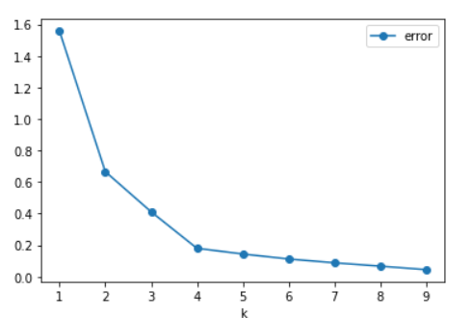

k-means clustering
1 to 9 clusters are tested, and the slope for error (total distance) flattened significantly after 4.
4 clusters will be optimal for this project.
It appeared that most cities in Santa Clara are similar (group 1), while there are 3 cities significantly different from others and form different clusters by themselves.

Slide 6
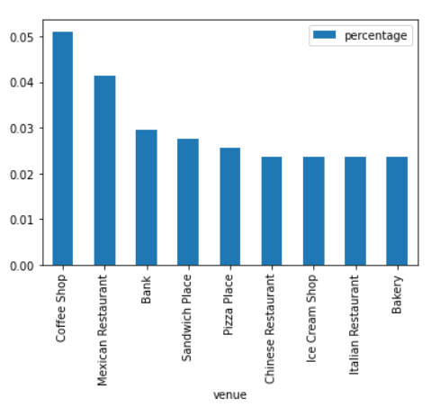
Comparison
Unfortunately, Irvine is one of the 3 cities that formed their own clusters.
The chart on the left shows top venues in cluster 1 (with most Santa Clara cities).
Focus more on food and drink shops.

Slide 7
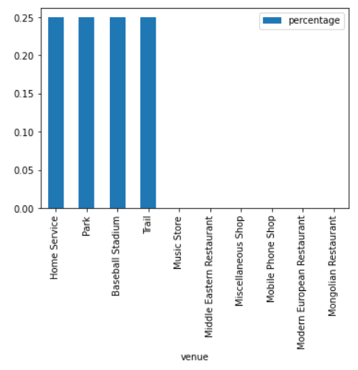
Comparison
Venues in Irvine, on the other hand, are sparsely distributed (only 4 captured in the radius).
Focus more on family activities.

Slide 8
conclusion
Unfortunately, Irvine is one of the 3 cities that formed their own clusters.
However, the data accuracy is a question, as there are not a lot of venue tracked by Foursquare API in Irvine.
Further studies will be helpful using different APIs and extract more venue information.

